Slide 1

Historical Leading Cause of Death IN NYC
University of Miami Data Analytics Project III
Presented by:
Leyre Chico
Elisabett Rico
Andre Spaulding

Slide 2

Contents
Project Charter
Process and Milestones
Methodology for Data Management
Development Process
Utilization of Data Science tools
HTML
MongoDB
Java Script
.CSV
Conclusion and Project III Results

Slide 3

Project iiI charter
The data we decided to use for our research is the leading causes of death in New York City. The first task as a team was finding data to use in our research . Fortunately, we were able to locate several data sources that we felt would be extremely useful for this project. Given the current climate of a heightened sense of personal health with the virus going around, our team felt this area of research would be interesting. We also wanted to explore how our gender and backgrounds affect this data. Our targeted search for relevant data sources:
Open Data
San Francisco Data
Google
Kaggle
Our initial hypothesis is the leading causes of death would be decreasing over
the time period within the data

Slide 4


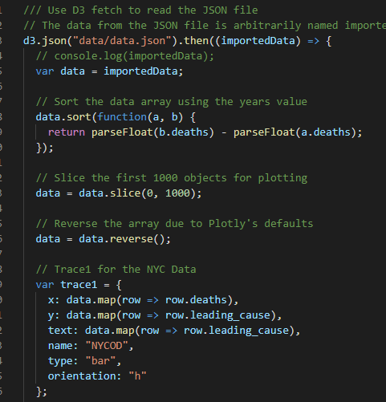

Data Manipulation and Data Base Creation
Research & Data Gathering
Discussion of project topic
Data Frame Creation and Cleansing
Created unique data frames from original csv’s with applicable data
Load Data Frames into MongoDB
A Data Base for this project was created in Mongo DB in order to have flexibility for new data in the future.
Search for relevant data in Kaggle and the online census data
Removed all nulls from the data
Removed the extra space and ensured the keys were properly formatted prior to the creation of the data base
Analyze Data & Make Conclusions
Created graphs to highlight and illustrate the leading causes of death by Ethnicity and Gender in NYC. The results of the graph showed the trends of these diseases over time in NYC
NYC Open Data Source
San Francisco Open Data
Google
Kaggle
Download Json format data through SODA API

Slide 5
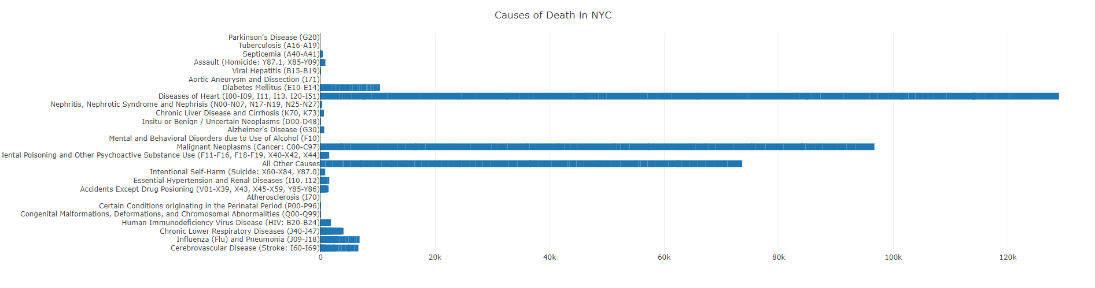
Leading Causes of Death in NYC
Regional Occurrence
This INTERACTIVE graph CREATED IN JS, identifies the leading causes of recorded deaths in NYC. NYC is home to a very diverse population and many disease are being tracked and recoded to ensure the medical community focuses and performs the necessary research on areas were they can make the Most impact. The Three leading causes of death were the following:
Heart Disease
Cancer
Diabetes

Slide 6
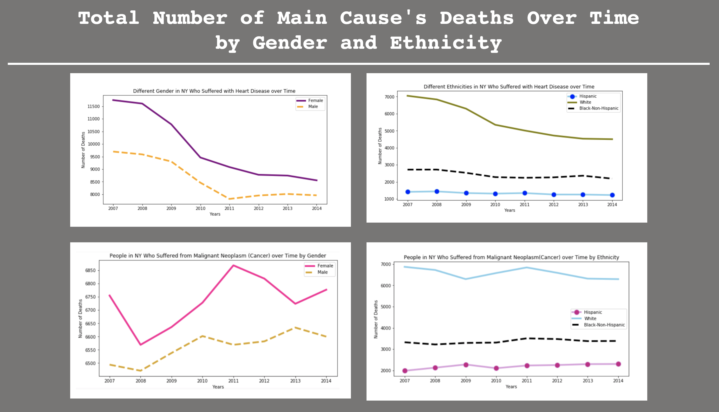

Slide 7

Conclusion and Project III Results
Scope of Problem: once the area of research was decided upon we located a data set we used to assist in the creation of a story board that we would use to highlight the causes of death in New York City.
Analysis: Over this seven year period the graphical results show a dramatic reduction in the occurrence of heart disease in both genders. There could be many factors that contribute to this reduction but these are not listed in the data. Those factors could be the following:
Improved Diet
Better medical care
Early detection
Reduction in the presence of causal factors
Healthy Life-Style
Results: The graph depicts the trending of heart disease in the three ethnicities listed below.
Hispanic
Black
White
Analysis: The graph shows a significant decrease in the occurrence of Heart disease in the white population whereas the occurrences in the black and Hispanic population remain constant. This could be due to the predisposition of those ethnicities but the only way to know for sure is to continue the research and additional funding and research in these areas could yield positive results.

